Slide 1
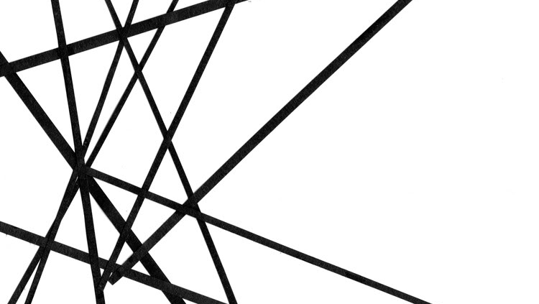
Final Project: Line Follower
By Carolyn Cressman and Ruben Vazquez

Slide 2

Project Description
Create a virtual robot that follows a given path
Using virtual vision sensors and virtual mobile robot platform

Slide 3
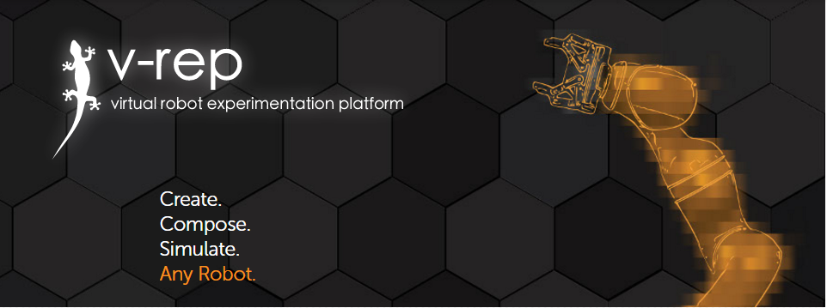
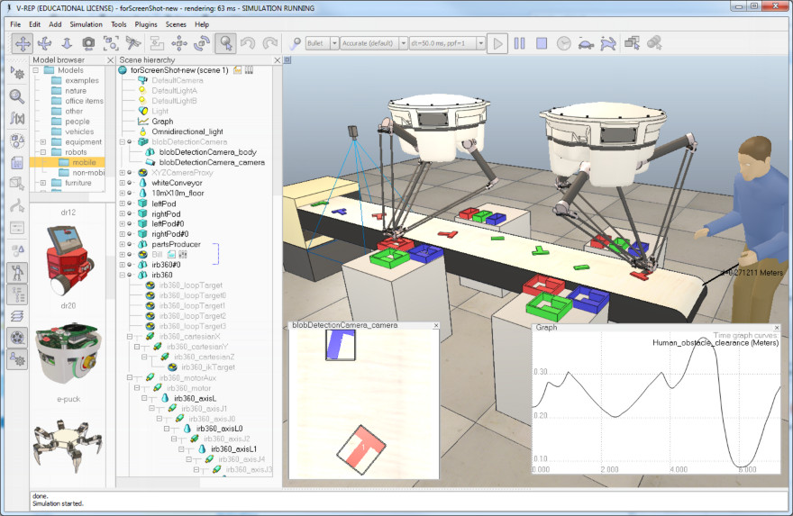
Environment
We created our line follower using an IDE called Vrep
Vrep is a free platform that creates virtual cad models to simulate robots
Each object/model can be controlled individually
Controllers can be written in C/C++. Python, Java, Lua, Matlab, or Octave

Slide 4
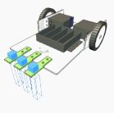
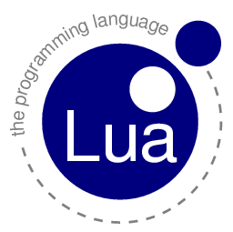
Line Follower
We used Vrep’s built-in Line follower as a base
The script for the line follower is written in Lua
Uses 3 vision sensors
We edited the line follower’s script to optimize the robot
We will use 2 vision sensors

Slide 5
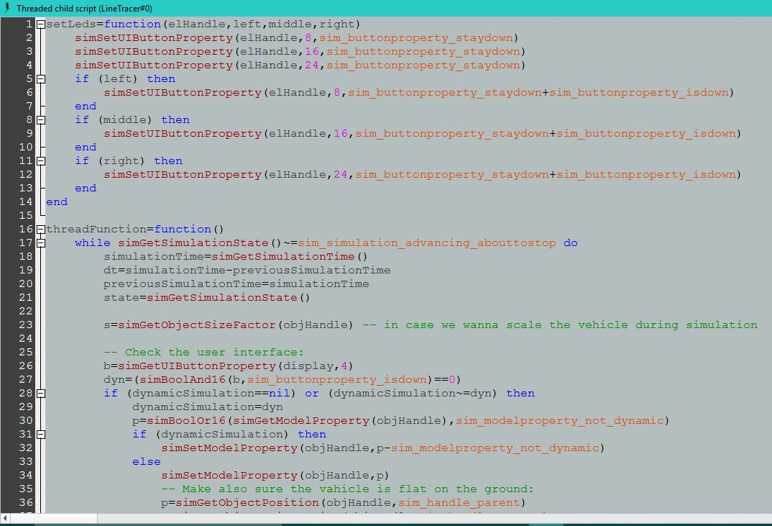
Line Follower Code: Original Code
Define function to display status for each sensor
Define main code in a function
Display simulation time
Check user interface
Read each sensor status and set indicators
Change velocities if needed
Move the robot
Initialize Variables
Run functions
Check for runtime errors

Slide 6
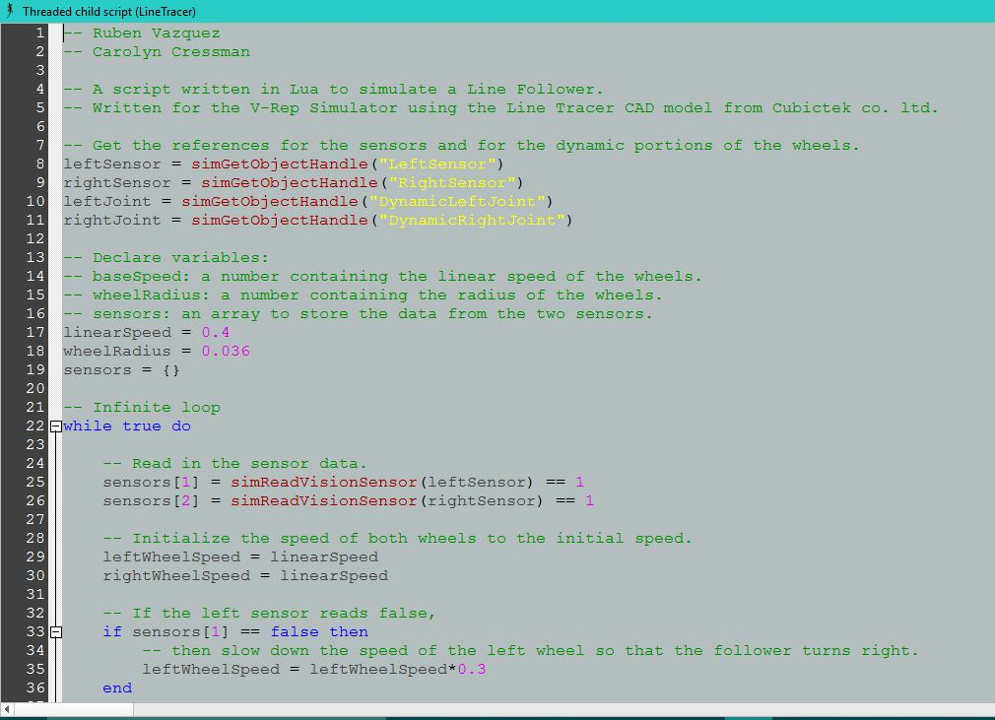
Line Follower Code: Our Design
Get references for the sensors and dynamic portions of the wheels
Declares variables: base speed, wheel radius, sensor array
Main code in infinite loop
Read sensors and compare to 1
Initialize wheel speeds
Adjust wheel speeds based on sensor comparison results
New speed = Current speed * 0.3

Slide 7
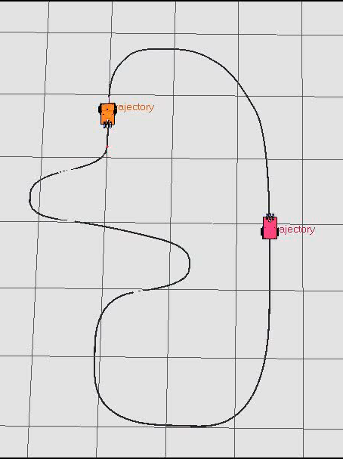
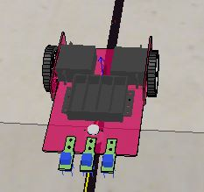
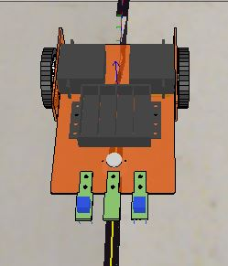
Performance
Compared to the 3 sensor original design
Similar accuracy
Tested on the same track with same initial values
3 Sensors Original Design
2 Sensors
Our Design

Slide 8
Conclusion
The original design can be optimize by removing a sensor
Performance remains the same once optimized
If we had more time we would
Test on multiple tracks
Attempt to make code work with 1 sensor

